Slide 1


Housing: How will the pandemic affect the housing market?
How did the pandemic affect unemployment in Georgia?
Group A2: Iyesogie(Stephany) Obakpolor, Donald Yakam Ngandeu, Nnamdi Obodoechine, Tina Huang,Asim Syed

Slide 2

The Original
In 2008 we witnessed the collapse of the housing market as a result of the stock market crash. Many feared the same would occur with the onset of the COVID-19 Pandemic, with the rise of unemployment. As the pandemic has continued we have seen interest rates drop and the price of homes increase. So the question that arises is “ What effect, if any, will the pandemic have on housing in the coming years?”.

Slide 3

The Questions
2018 to 2020
- What effect has the pandemic had on household income?
- How has the pandemic impacted interest rates?
-What is the impact of the pandemic on unemployment?

Slide 4

The Source
-Data USA puts public US Government data in your hands.
-an open, easy-to-use platform
-It allows people to conduct their own analyses and create their own stories

Slide 5
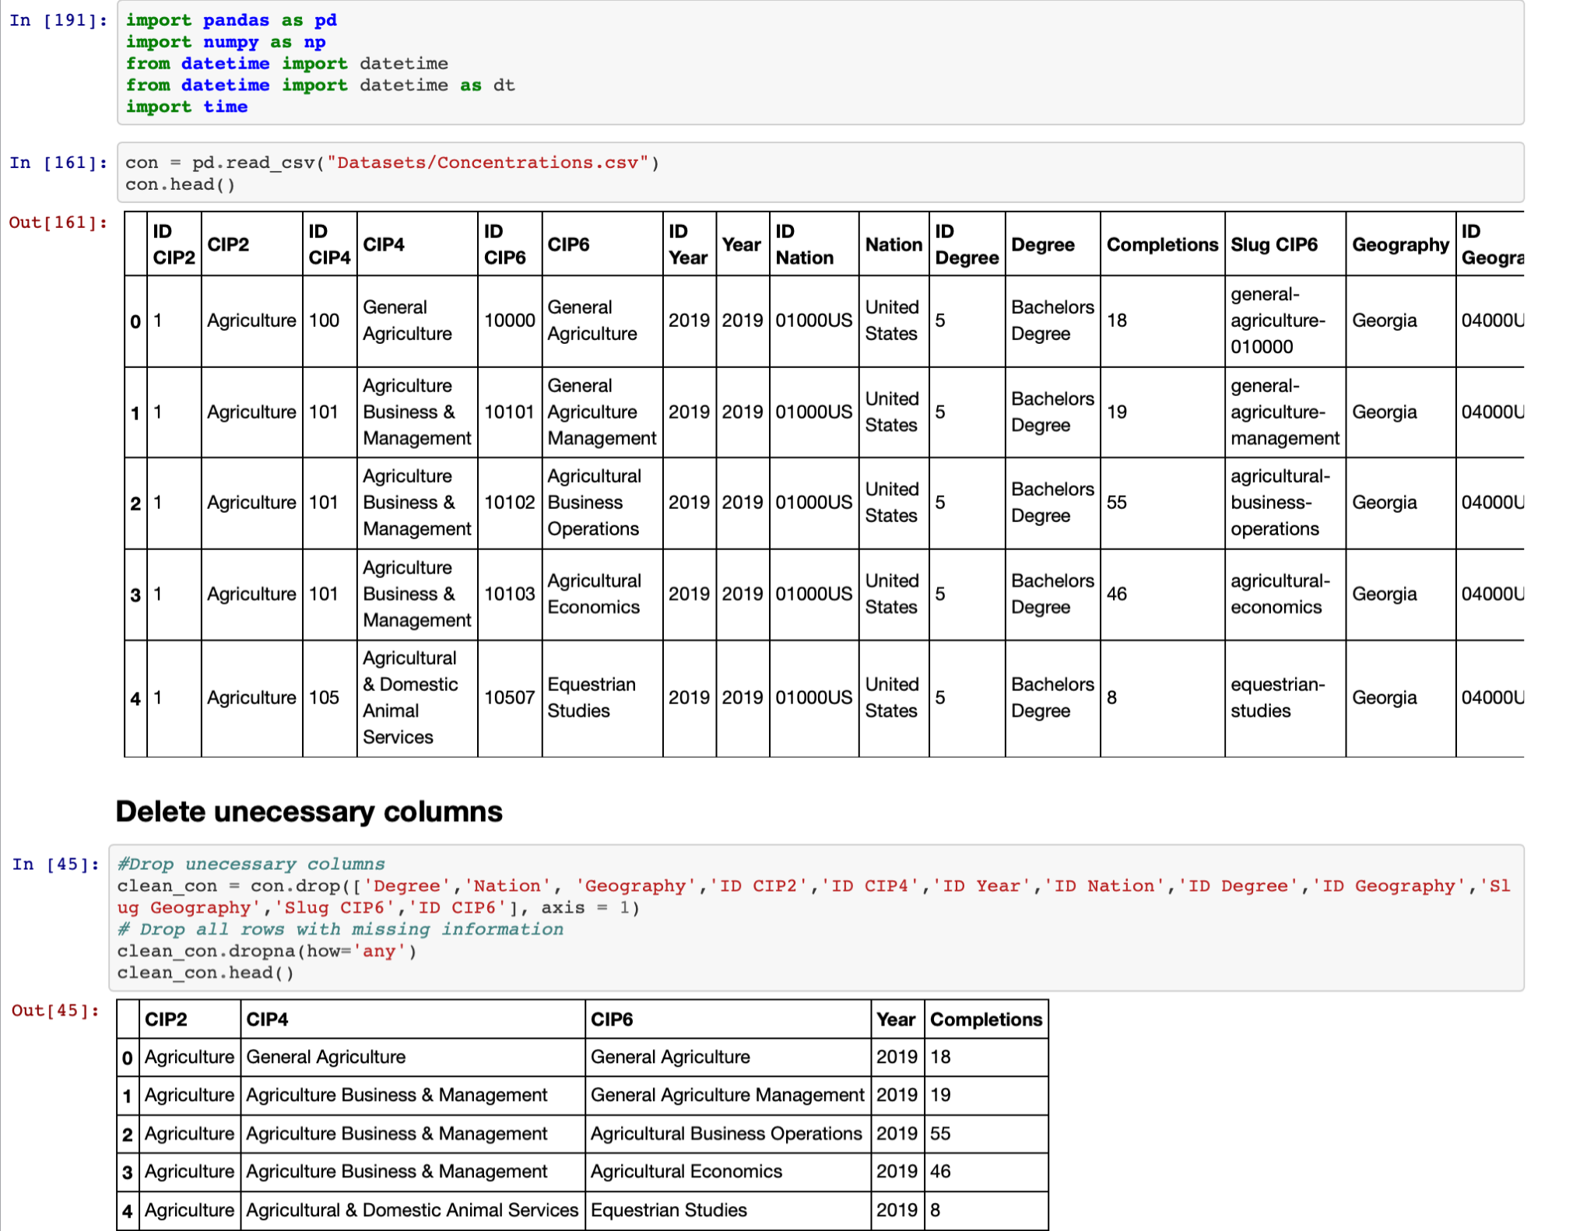
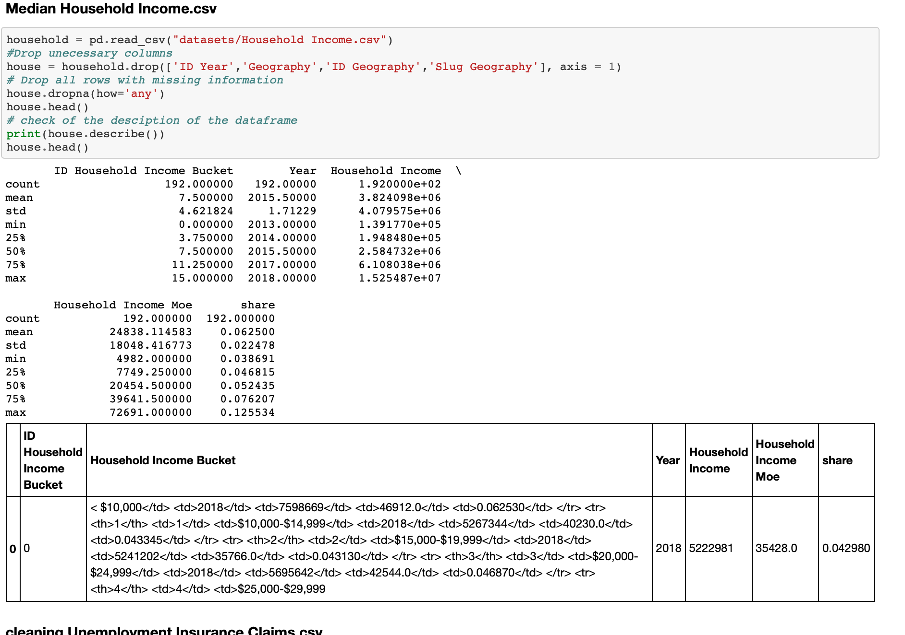
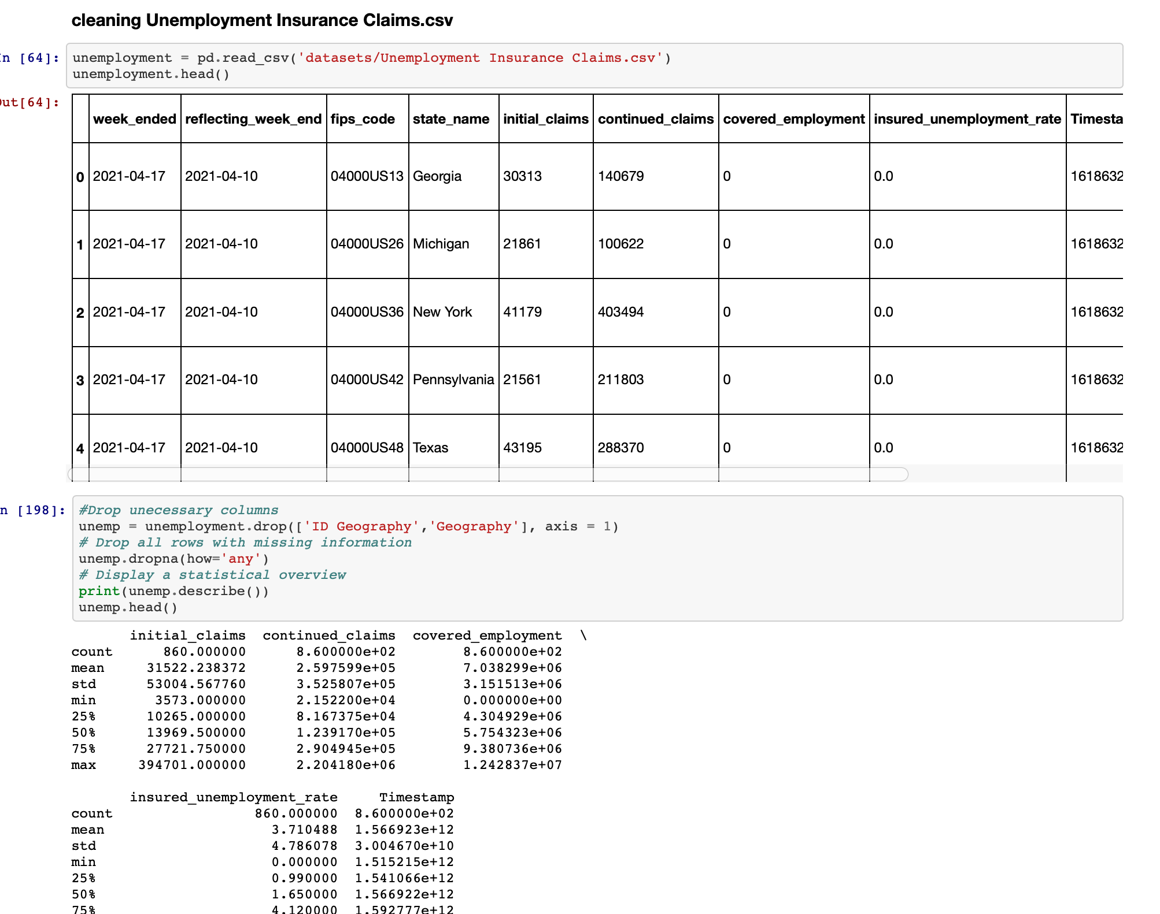
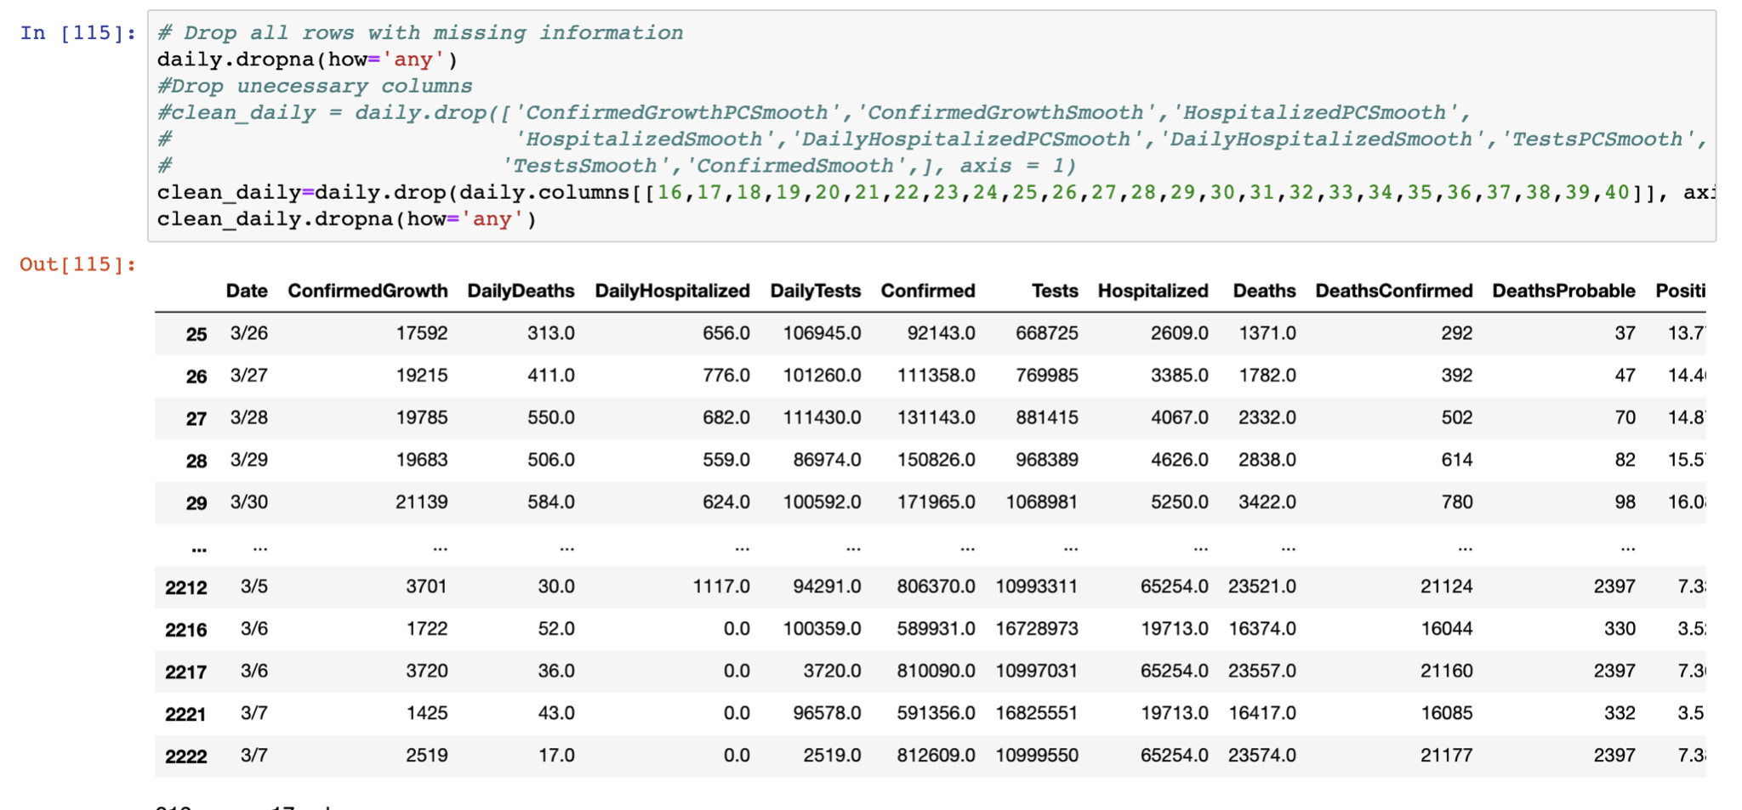
The Data- The original
Drop unnecessary columns
Drop all rows with missing information

Slide 6

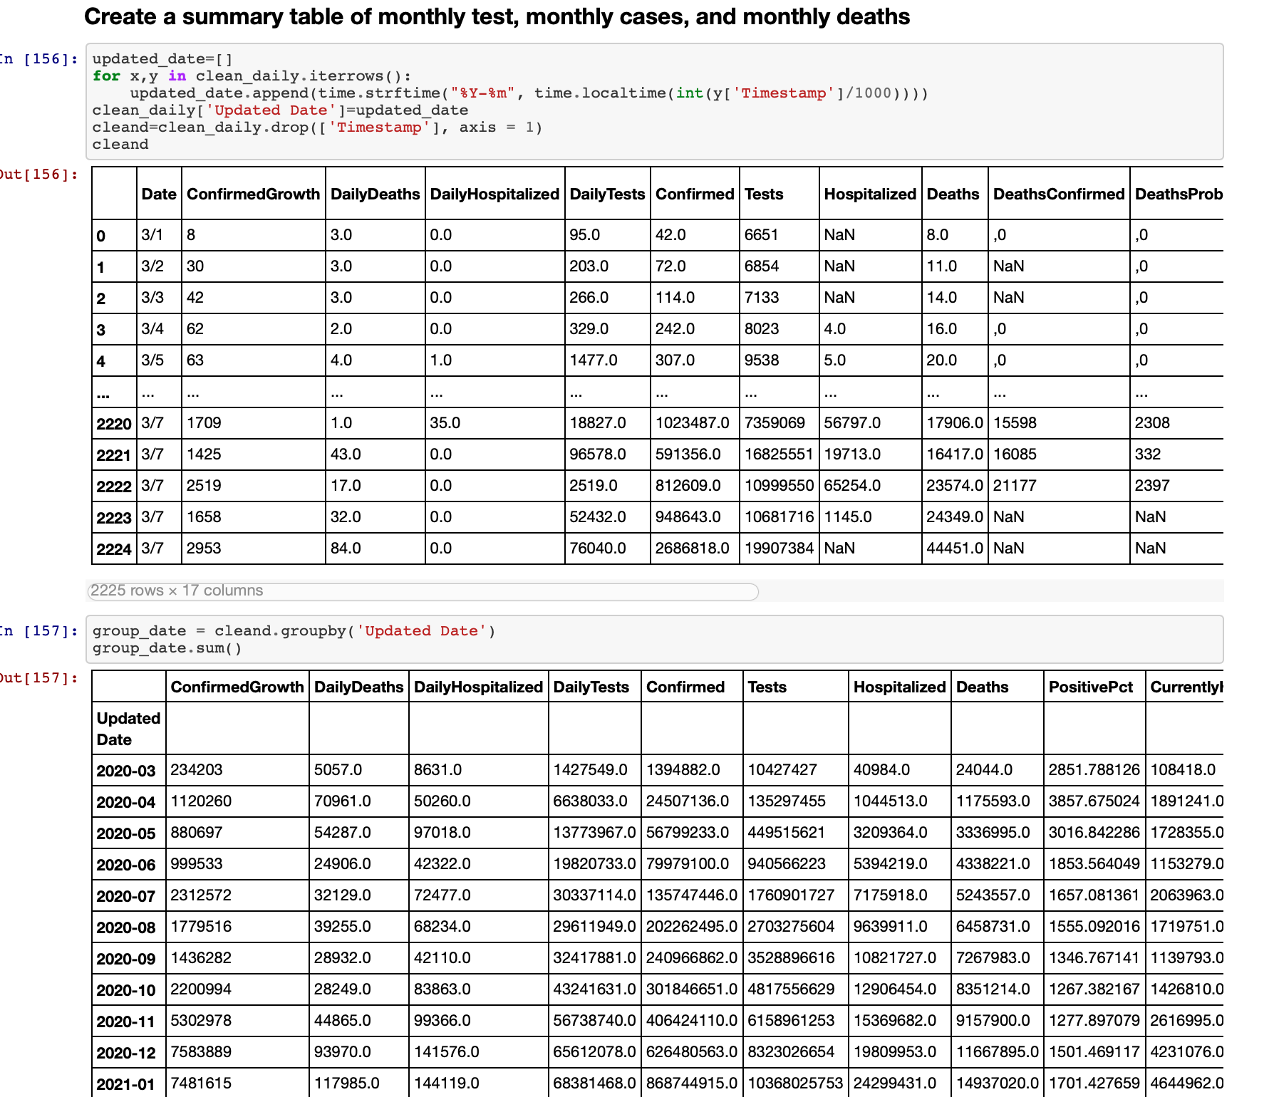
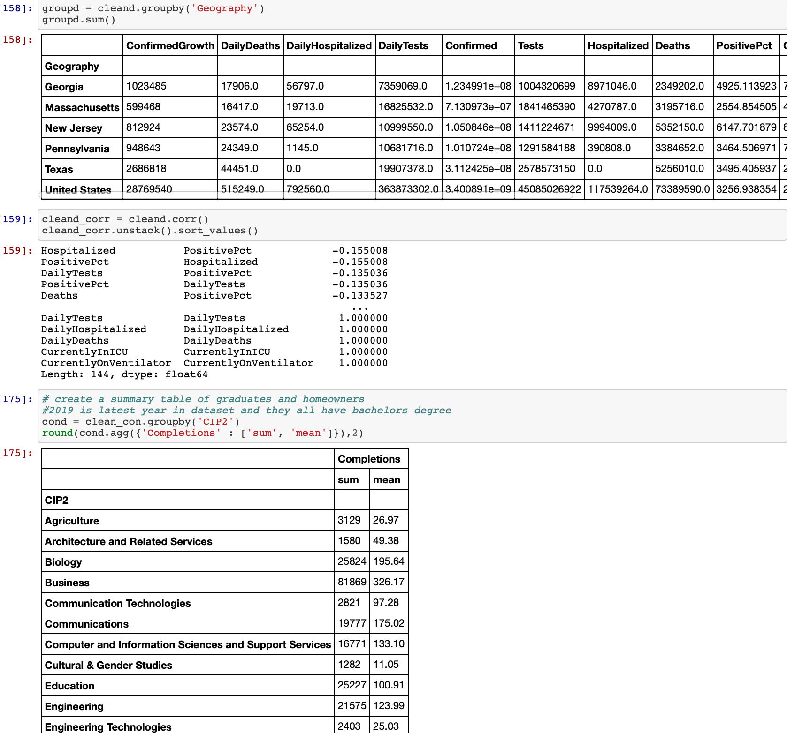
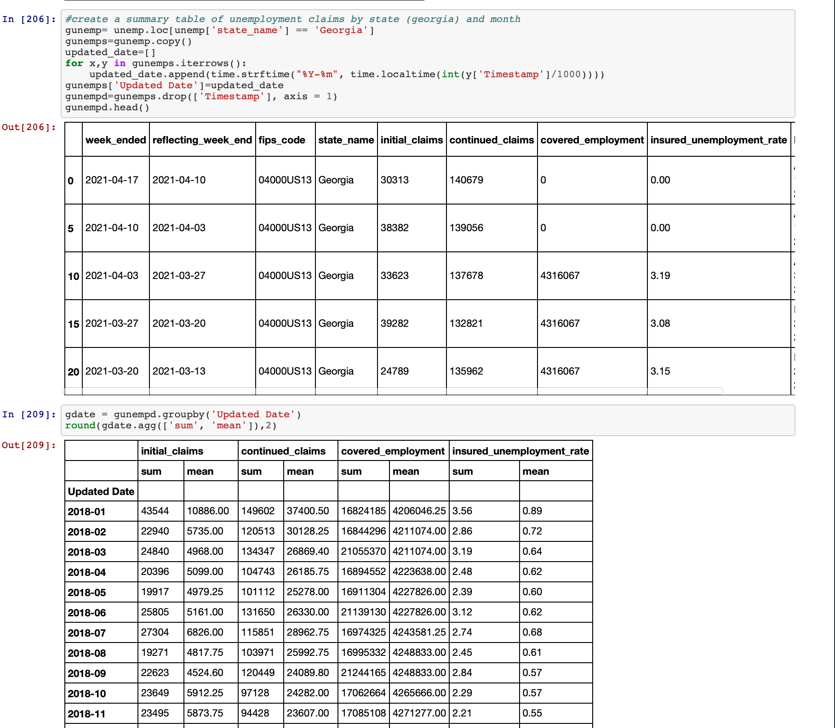
The Data- The original
Create Summary tables
Mean
Sum
Timestamp
Groupby

Slide 7


Slide 8

The Pivot
Questions but not enough data
“What do we have?”

Slide 9
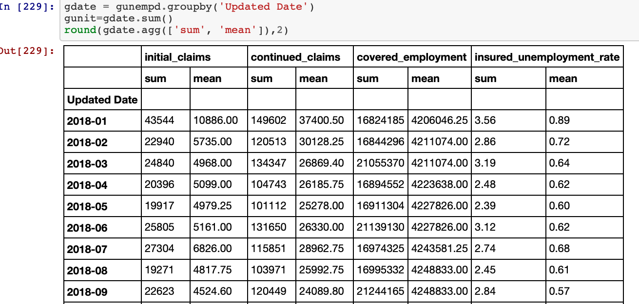
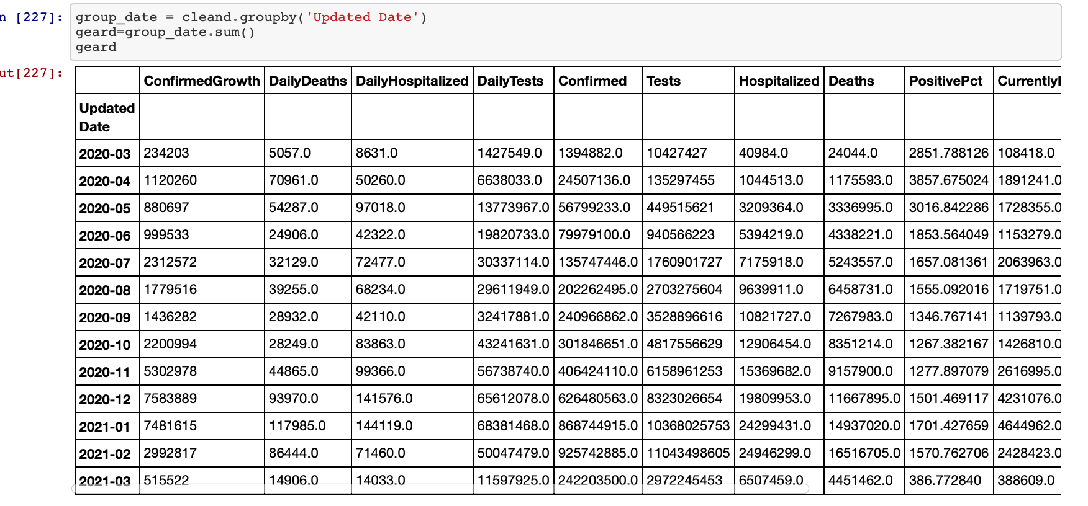
Let’s Merge Drop months and merge
Unemployment Data
Covid - 19 Data

Slide 10
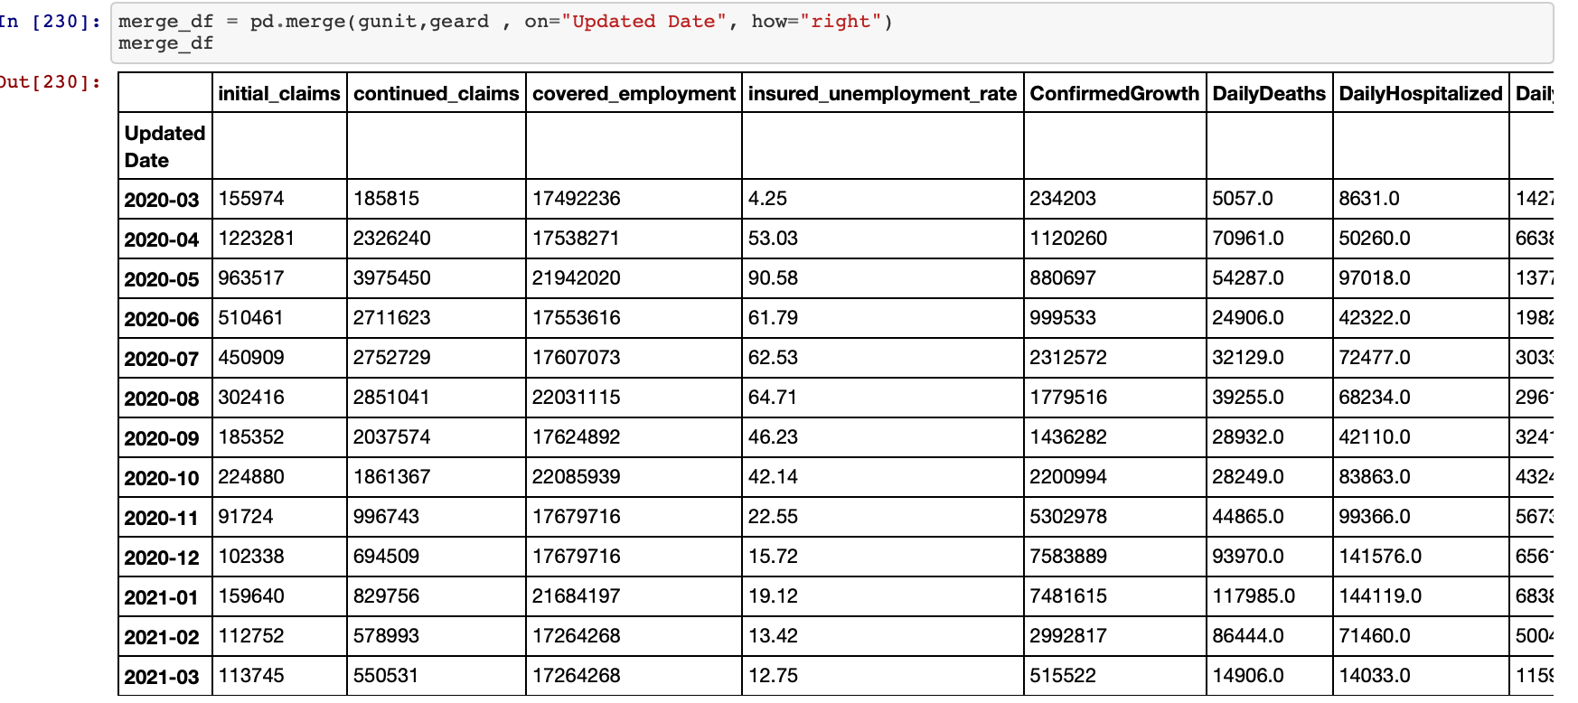
The remix

Slide 11
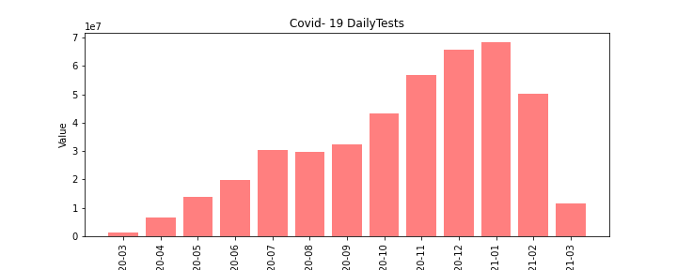
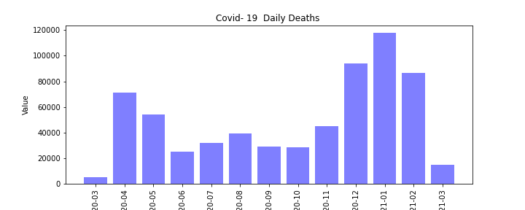
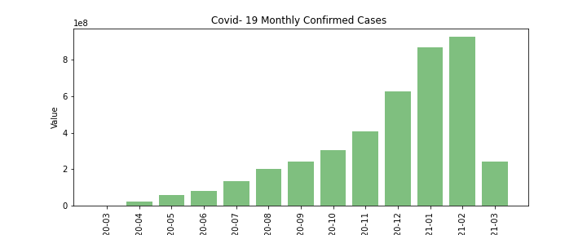
The Questions - The Remix
What is the relationship between the number of covid test administered and the number of confirmed cases/deaths?

Slide 12
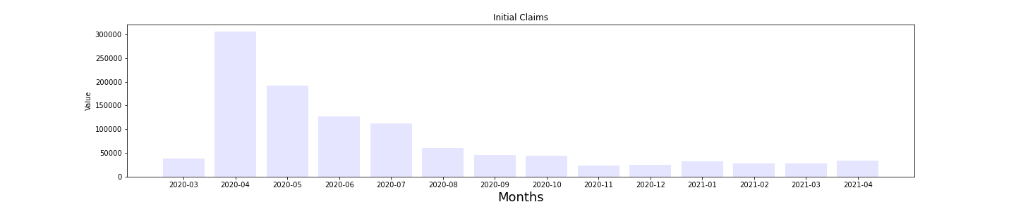
The Question-The Remix
2) what is the relationship between the initial number of unemployment case and the the number of test?

Slide 13
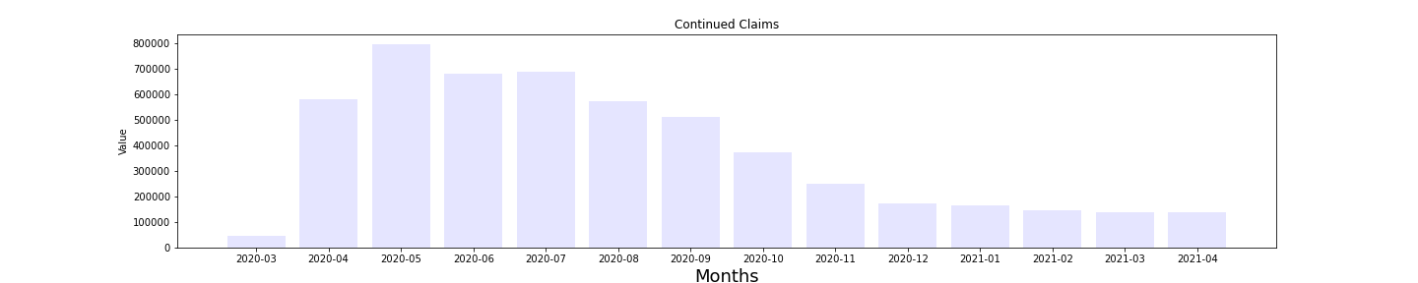
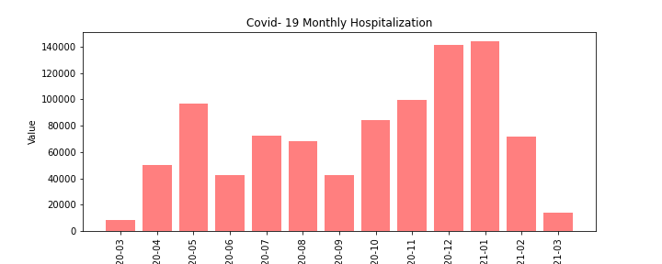
The Question-The Remix
3) What is the relationship between the number of hospitalizations and the continued unemployment claims?

Slide 14
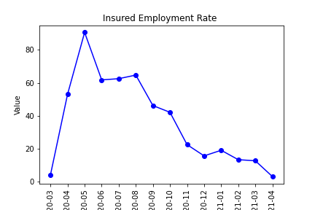
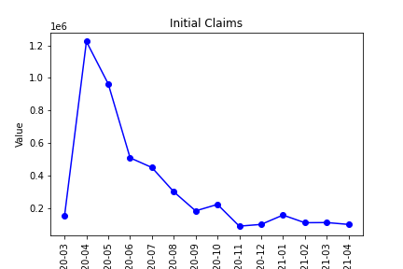
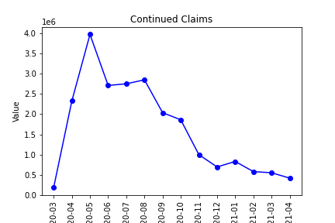
The Question-The Remix
What is the relationship between the number of initial unemployment claims, the continued claims and the unemployment rate

Slide 15
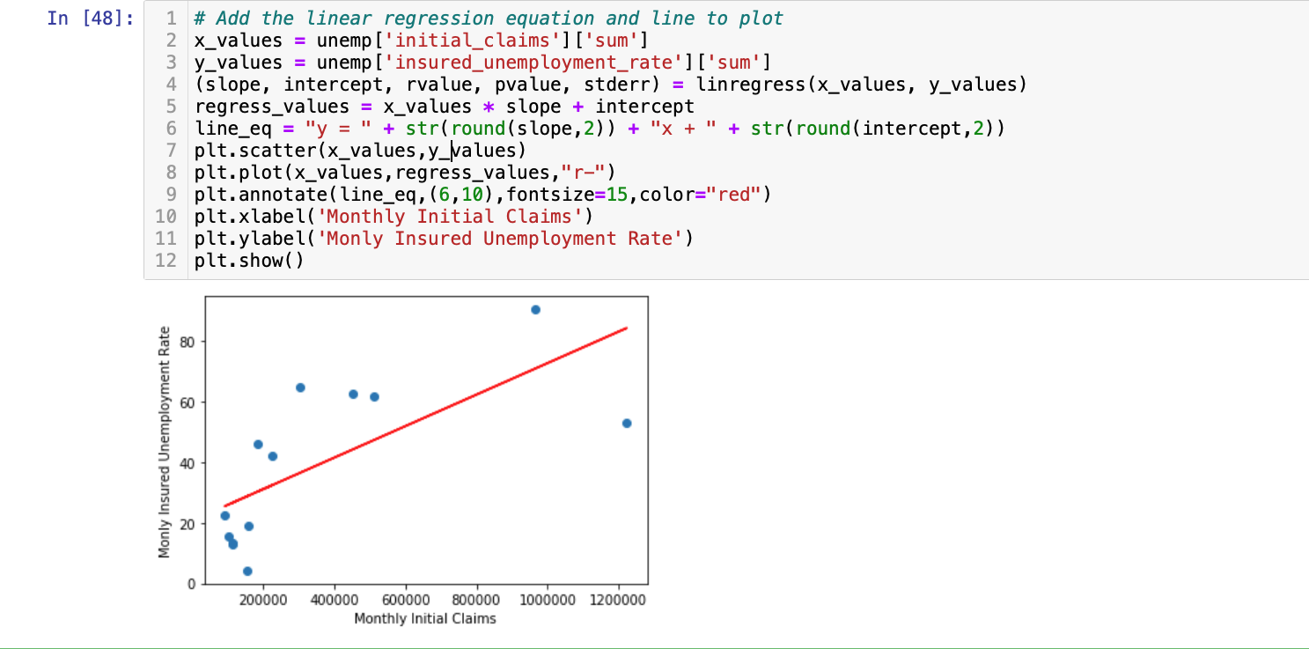
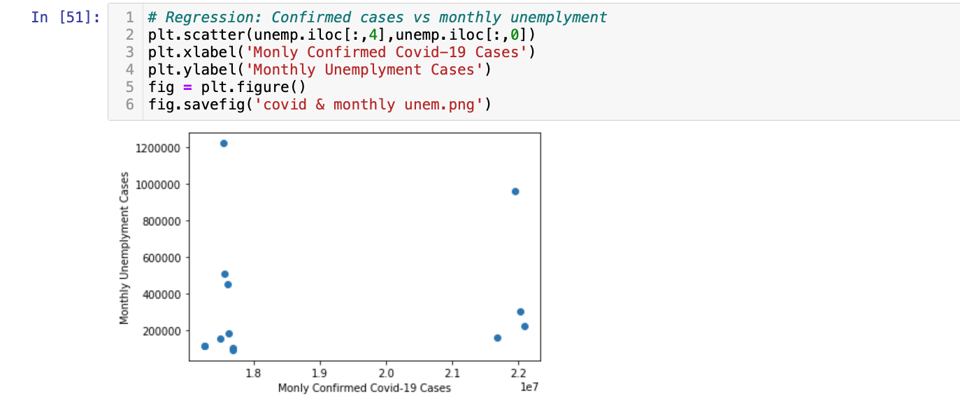

Slide 16
The Findings
There were significantly more test administered than confirmed cases and deaths, especially during the last quarter of 2020. Then we see a dramatic drop in the number of test administered in the first quarter of 2021.
As the pandemic began we saw a large amount on initial unemployment case, however there we had far fewer test administered. Then we see a swap as the number of test increased the number of initial unemployment claims decreased.

Slide 17
The Findings
Throughout the pandemic there has been steady number of hospitalizations. However we can see a spike in the months that had a decreased number of continued cases
The initial claims and continued claims have pretty much mirrored each other, causing the unemployment rate to do same.

Slide 18
Questions ?

